Slide 1
IBM University Engagement Project Submission
“Exploring the Power of Agentic AI with IBM Granite”

Slide 2
Project Title – Agentic AI for Personalized Course Pathways
Domain of Project – Education
Student Name | Recent Passport Photo | Email ID | Mobile number [WhatsApp]
Anam Azhar Shaikh |  | anamsk9338@gmail.com

Slide 3
Problem Statement -
Problem Statement – Agentic AI for Personalized Course Pathways
The Challenge
Students often struggle to identify the right learning path that aligns with their interests and long-term goals due to the overwhelming number of online courses and a lack of personalized guidance. LearnMate aims to solve this by acting as an Agentic AI coach that interacts with students, understands their interests (like Frontend Development, Cybersecurity, UI/UX Design, etc.), assesses their current skill level, and dynamically builds a personalized course roadmap that adapts over time based on progress and preferences.
The Objective
Build an AI-powered Personalized Learning Agent that delivers customized learning pathways and career guidance for students, working professionals, and self-learners. The solution should:
Personalized Learning Roadmaps – Recommend career-specific learning paths based on current skill level, career track, learning goals, and difficulty tier across 7 professional domains.
Knowledge Retrieval & AI Guidance – Fetch and generate accurate learning content covering Data Science, Machine Learning, Deep Learning, NLP, SQL, Python, Statistics, and more using IBM Granite LLM.
Skill Assessment & Feedback – Allow users to take adaptive quizzes, evaluate their knowledge level, and receive instant performance analysis with actionable next steps.
Career Goal Focus – Suggest learning paths aligned with specific career goals such as Data Scientist, ML Engineer, Web Developer, Business Analyst, and more.
Multi-Component Agentic System –
AI Chat Coach (answers personalized learning queries)
Skill Assessment Agent (evaluates and adjusts student level)
Course Recommendation Agent (personalized course suggestions)
Learning Roadmap Agent (structured career-track pathways)
Visualization Dashboard – Display skill levels, XP points, learning streaks, completed courses, badges, and progress toward career goals in an interactive student dashboard.

Slide 4
Proposed Solution -
Proposed Solution: AI-Powered Personalized Learning Agent
The proposed solution is a multi-component AI-powered Learning Agent built using Python Flask, IBM watsonx.ai, and IBM Granite Models to provide personalized, real-time learning guidance. The system addresses challenges in career planning, skill assessment, and course recommendations through an intelligent, modular architecture.
At its core, the solution uses an Agentic AI pipeline to deliver accurate and context-aware learning content from a comprehensive built-in knowledge base covering Data Science, Machine Learning, Deep Learning, NLP, SQL, Python, and more. This knowledge is processed and served through IBM Granite models, enabling the system to retrieve and generate personalized learning content tailored to each student's profile.
The system consists of four key components:
AI Chat Coach retrieves and generates personalized learning guidance using IBM Granite LLM, answering student queries with context-awareness based on their career track, level, and goals.
Skill Assessment Agent evaluates student knowledge through adaptive quizzes and automatically adjusts the difficulty level and learning path based on quiz performance and results.
Course Recommendation Agent generates personalized course suggestions based on user inputs such as career track, current skill level, learning progress, and fitness goals across 7 career tracks.
Learning Roadmap Agent provides structured, goal-driven learning roadmaps across 3 difficulty tiers — Beginner, Intermediate, and Advanced — with milestone tracking and progress visualization.
The solution includes a user-friendly dashboard built with Python Flask and Vanilla HTML/CSS that visualizes skill levels, XP points, learning streaks, completed courses, and progress toward career goals.
IBM watsonx.ai is used to power the AI Chat Coach, while IBM Granite 3.3 ensures scalable model inference, personalized reasoning, and responsible AI governance. A rich fallback knowledge base ensures uninterrupted guidance even without API connectivity.
Overall, this solution delivers an end-to-end intelligent learning assistant that empowers students to achieve their career goals through personalized roadmaps, real-time AI coaching, and adaptive skill development.

Slide 5
Technology Used
• Python Flask – For designing and building the web application, handling routing, session management, and serving the AI-powered learning platform to end users.
• IBM Granite Model – For e.g. ibm/granite-3-3-8b-instruct – For natural language understanding, reasoning, and personalized learning guidance tailored to each student's profile and career goals.
• IBM Cloud – It provides access to IBM's cloud infrastructure and AI services to support the development and integration of LearnMate, enabling a reliable and scalable AI-powered learning experience.
• Agentic AI Architecture – To design and orchestrate multiple intelligent components — AI Chat Coach, Skill Assessment Agent, Course Recommendation Agent, and Learning Roadmap Agent — working collaboratively to deliver personalized guidance.
• IBM watsonx.ai – For foundation model inference, integration with IBM Granite, and AI capabilities that enable responsible and scalable AI interactions within the LearnMate platform.
• Vanilla HTML / CSS / JavaScript – For building a responsive, user-friendly frontend dashboard that visualizes skill levels, XP points, learning streaks, progress tracking, and course recommendations without any external framework dependency.

Slide 6
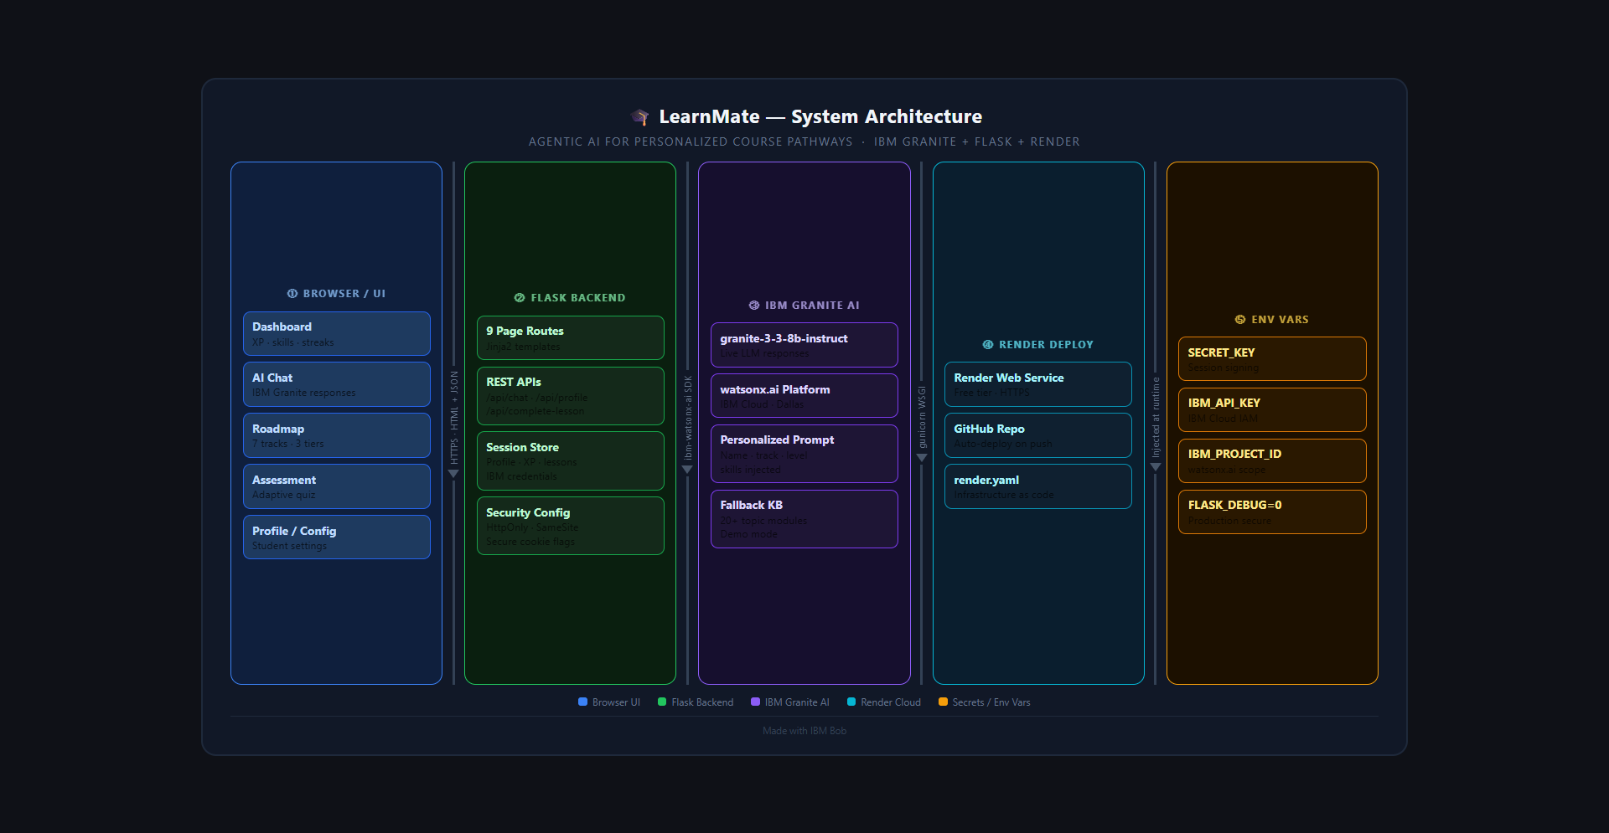
Architecture blueprint

Slide 7

Role of Agentic AI in the solution
Role of Agentic AI in LearnMate
Agentic AI enables LearnMate to function as an intelligent, autonomous system rather than a simple chatbot. Using IBM watsonx.ai and IBM Granite 3.3 models, it coordinates multiple specialized components to deliver personalized learning guidance.
Each component performs a specific role — such as retrieving course data, generating learning roadmaps, providing skill assessments, and analyzing student progress — while working collaboratively. This multi-agent approach ensures efficient task execution and accurate results.
Agentic AI also brings context awareness, understanding user details like career track, current skill level, learning progress, and goals to generate tailored recommendations. It supports real-time adaptation, continuously updating suggestions based on user inputs like quiz results and completed courses.
Additionally, agents communicate with each other, enabling better decision-making and improved learning outcomes.
Overall, Agentic AI makes the system proactive, personalized, and goal-driven, acting like a smart digital learning coach that helps students achieve their career goals effectively.

Slide 8
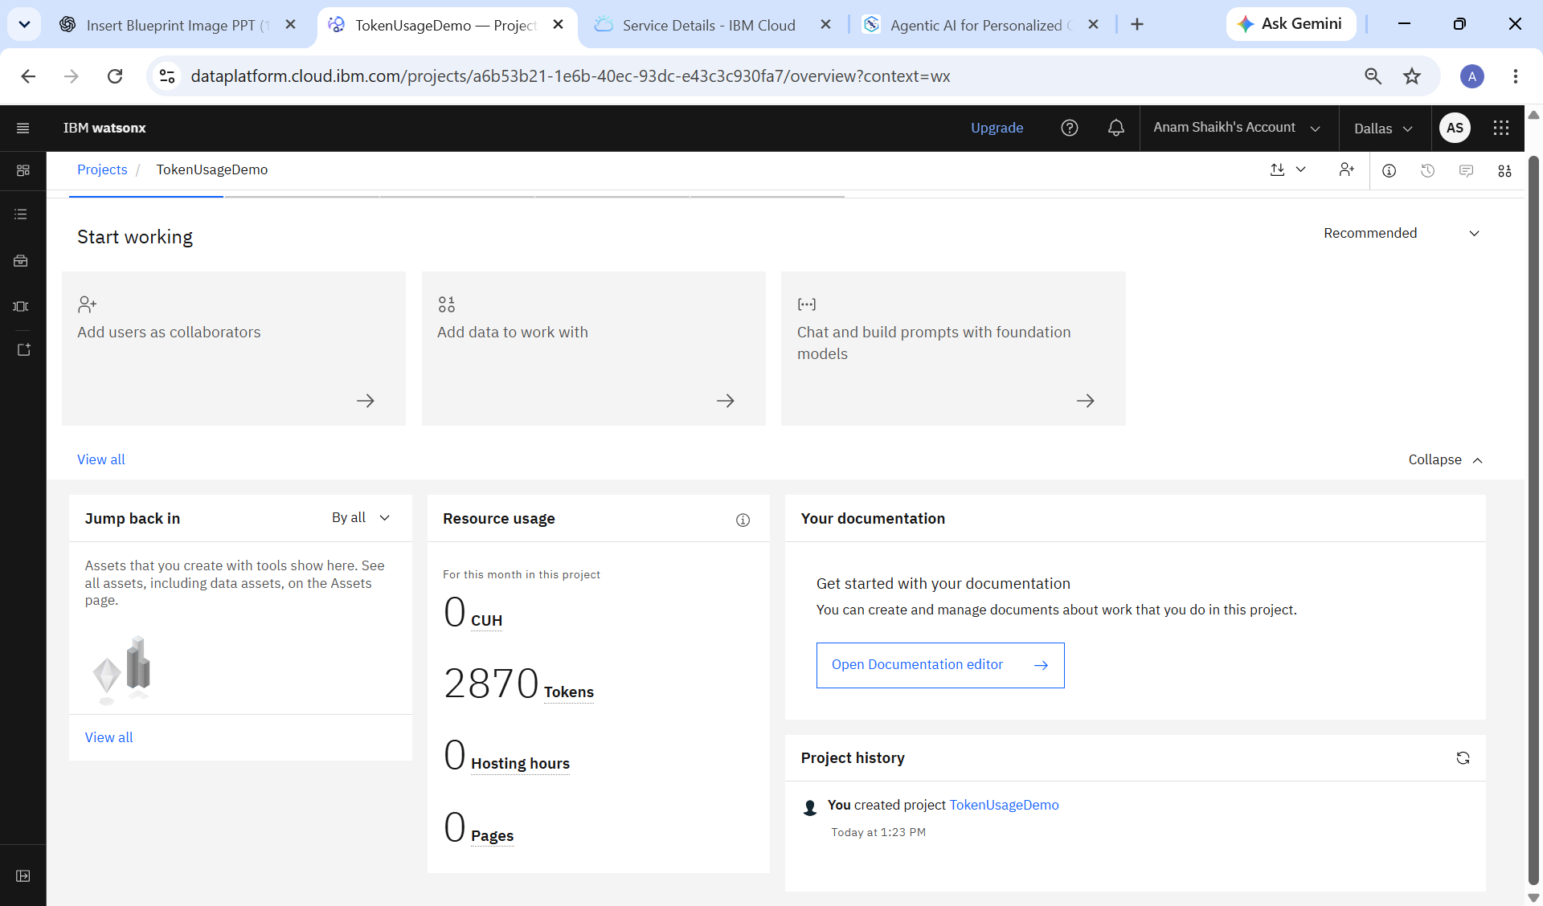
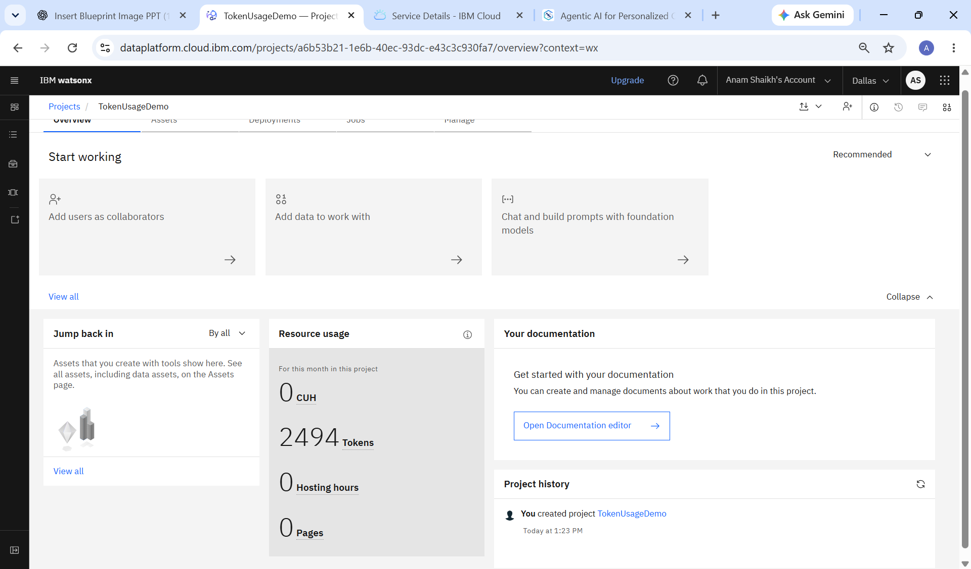
Token Usage
376 token are used
Before Prompt
After the Prompt
·
·
·

Slide 9
Novelty and Uniqueness
The proposed LearnMate stands out by combining Agentic AI, personalized learning pathways, and real-time skill tracking into a single intelligent system.
Multi-Agent Intelligence – Instead of a single chatbot, multiple specialized components collaborate — including a skill assessor, roadmap generator, course recommender, and AI chat coach — to deliver accurate and context-aware learning guidance.
Agentic AI-Powered Personalization – Unlike static course platforms, LearnMate acts as an autonomous agent that understands each student's career track, skill level, learning progress, and goals to generate truly personalized recommendations.
Adaptive Skill Assessment – The system continuously evaluates student performance through quizzes and automatically adjusts the difficulty level and learning path, creating a dynamic feedback loop that evolves with the learner.
Career-Track Roadmapping – Provides structured learning roadmaps across 7 career tracks and 3 difficulty tiers, giving students a clear, goal-driven path from beginner to job-ready — something no generic chatbot offers.
Multilingual Support – Supports responses in Marathi along with English, making quality AI-powered education accessible to regional language learners and bridging the language gap in tech education.
This makes LearnMate a smart, adaptive, and proactive digital learning coach — not just a static course recommendation tool.

Slide 10
Git Hub Link
Github URL –https://github.com/AnamShaikh-code/Agentic-AI-for-Personalized-Course-Pathway
Explore Learnmate- LIVE Demo
·
·
·

Slide 11
Future Scope
Google Sign-In & Social Authentication –
The system can be integrated with Google Sign-In and other social authentication providers such
as GitHub and LinkedIn. This will allow students to log in instantly without creating a separate account, improving user experience and reducing friction during onboarding.
2. Mobile Application Development –
LearnMate can be extended into a dedicated mobile application for Android and iOS platforms. This will allow students to access their personalized learning roadmap, chat with the AI coach, and track their progress anytime and anywhere, making learning more flexible and convenient.
3. Peer Learning & Community Forum –
A community-driven discussion forum can be added where students following the same career track can interact, share resources, ask questions, and collaborate. This will foster peer learning and create a supportive learning environment within the platform.
·
·
·

Slide 12
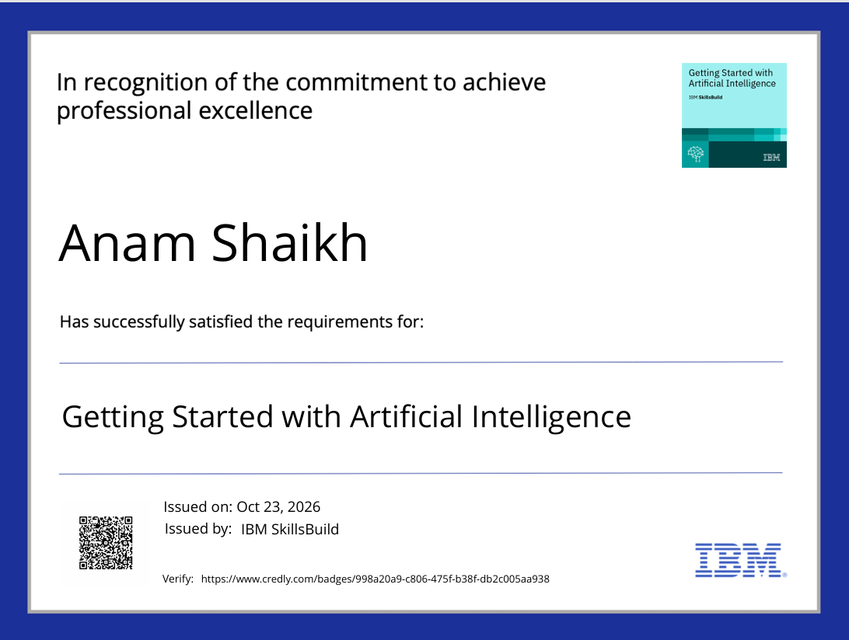
Certificates Earned:
Please add your credly certificate

Slide 13
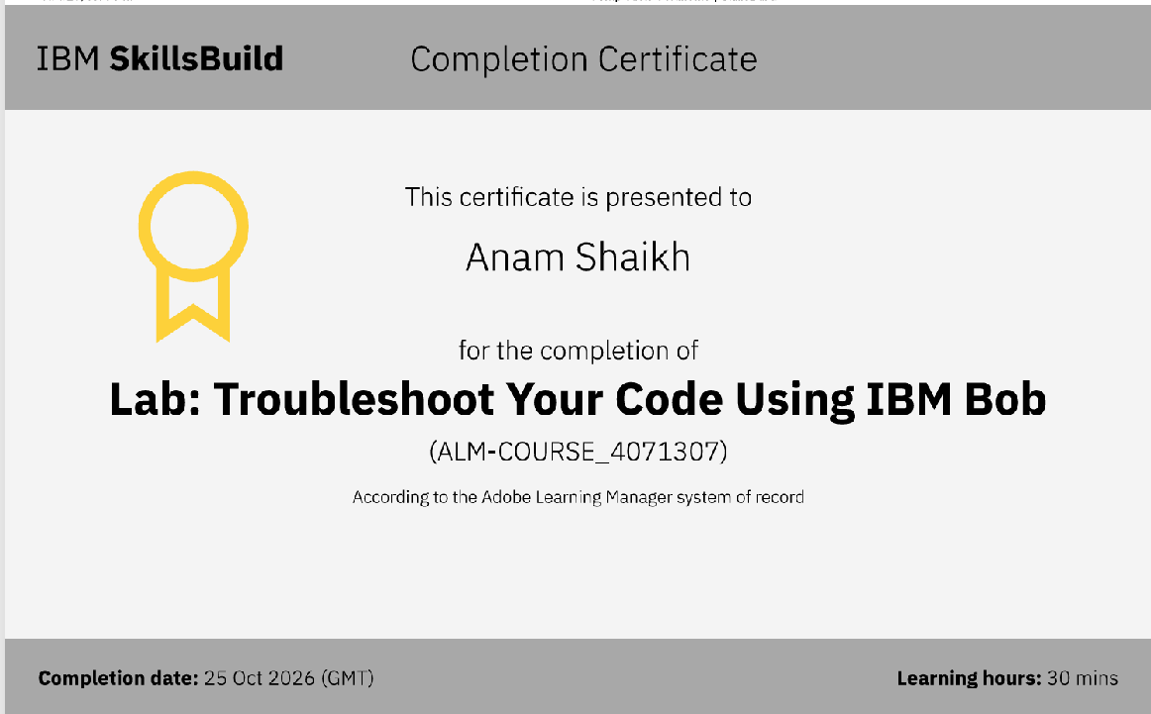
Certificates Earned:​
Add your IBM BOB Certificate

Slide 14


